Slide 1
Introduction to LaTeX & Lab Practices (CSC 101)
B.Sc. Computer Science

Slide 2

Basic Document Structure
The format of a document is pretty simple.
In the preamble
Documentclass
Packages
In the front matter
Title/author
In the body
Contents
In the back matter
bibliography

Slide 3
What is LaTeX?
LaTeX is pronounced “lay-tech” or “lah-tech,” not “la-teks.”
LaTeX is a document preparation system for high-quality typesetting.
LaTeX is most often used to produce technical or scientific documents, but it can be used for almost any form of publishing.

Slide 4
Why use LaTeX ?
LaTeX is a high-quality typesetting system; it includes features designed for the production of technical and scientific documentation.
LaTeX is the de facto standard for the communication and publication of scientific documents.
It also has a prominent role in the preparation and publication of books and articles that contain complex multilingual materials.
LaTeX uses the TeX typesetting program for formatting its output, and is itself written in the TeX macro language.

Slide 5
In the Preamble
You specify your document class.
Document classes: letter, article, report, book
\documentclass[12pt]{article}
Backslash – at the beginning of text markup command
Packages: numerous packages are available
\usepackage{geometry}
\usepackage{setspace}
\usepackage{harvard}
\usepackage{amsmath}

Slide 6
In the Front Matter
\begin{document}
\title{}
\author{}
\maketitle
\begin{abstract}
\end{abstract}
\pagebreak

Slide 7
In the Body
To begin a new section
\section{}
Similarly, \subsection{}, \subsubsection{}, \subsubsubsection{}
LaTeX does automatic numbering. If you don’t like it, use section*{}
\emph{}, \textbf{}
\singlespacing, \doublespacing, \onehalfspacing
\centering or \begin{centering} & \end{centering}

Slide 8
In the Back Matter
Don’t forget bibliography{filename}
Make sure that the bibtex file is saved in the same location where the main tex file is saved.
Don’t forget end{document}

Slide 9
Sample Document

Slide 10
The basic layout of a LaTeX file
All commands share the following structure: \commandname{option}.
The first part indicates the name of the command and the second part in braces sets an option for this command.
The options vary from command to command
Most of the time, the commands are pretty self-explanatory: \documentclass{article}

Slide 11
The basic layout of a LaTeX file
Syntax:
% Valid:
\begin{document}
\begin{environment1}
\begin{environment2}
\end{environment2}
\end{environment1}
\end{document}

Slide 12
The basic layout of a LaTeX file
Syntax:
%Invalid:
\begin{document}
\begin{environment1}
\begin{environment2}
\end{environment1}
\end{environment2}
\end{document}

Slide 13
First LaTeX document
LaTeX uses control statements, which define how your content should be formatted.
Before you can see what the final result looks like, the LaTeX compiler will take your .tex file and compile it into a .pdf file.
\documentclass{article}
\begin{document}
Hello World!
\end{document}

Slide 14
Sectioning elements
Syntax:
\section{}
This is section 1
\subsection{}
This is section 1.1
\subsubsection{}
This is section 1.1.1
\paragraph{}
\subparagraph{}

Slide 15
Using LaTeX packages
LaTeX offers a lot of functions by default, but in some situations it can become in handy to use so called packages.
To import a package in LaTeX, you simply add the \usepackage directive to the preamble of your document:
Syntax:
\documentclass{article}
\usepackage{PACKAGENAME}
\begin{document} ...

Slide 16
Purpose of LaTeX packages
There are countless packages, all for different purposes.
To typeset math, LaTeX offers (among others) an environment called equation.
Everything inside this environment will be printed in math mode, a special typesetting environment for math.
LaTeX also takes care of equation numbers.

Slide 17
Unordered List (Itemization)
Syntax:
\begin{itemize}
\item Ayomide
\item Kamsi
\item Eboseta
\end{itemize}

Slide 18
Ordered List (Itemization)
Syntax:
\begin{enumerate}
\item David
\item Precious
\item Tabitha
\end{enumerate}

Slide 19
Mathematical notations
Latex is capable of displaying ant mathematical notation.
It is possible to typeset integrals, fractions and more.
It is possible to combine various commands to create more sophisticated expressions.
The more complex the expression, the more error prone.
It is important to take care of opening and closing the braces {}

Slide 20
Mathematical notations
Syntax:
\begin{align*}
f(x) &= x^2\\
g(x) &= \frac{1}{x}\\
F(x) &= \int^a_b \frac{1}{3}x^3
\end{align*}

Slide 21
Combining various command …
Syntax:
\begin{equation*}
F(x) = \frac{1}{\sqrt{x}}
\end{equation*}

Slide 22
Matrices
It is possible to display matrices in Latex.
The matrices only work within math environments.
To surround the matrix by brackets, it is necessary to use special statements, as plain [ ] symbol do not scale as the matrix grows.

Slide 23
Matrix continued…
Syntax:
\begin{equation*}
\left[
\begin{matrix}
1 & 0\\
0 & 1
\end{matrix}
\right]
\end{equation*}

Slide 24
Insert images
Using LaTeX all images are indexed automatically
Images are tagged with successive numbers when using the figure environment and graphic package.
The figure environment takes care of the numbering and positioning of the image within the document.
Use \includegraphics command to include image.

Slide 25
Insert Image
Syntax:
\begin{figure} \includegraphics[width=\linewidth]{boat.jpg}
\caption{A boat.}
\label{fig:boat1}
\end{figure}

Slide 26
Laboratory Practice

Slide 27
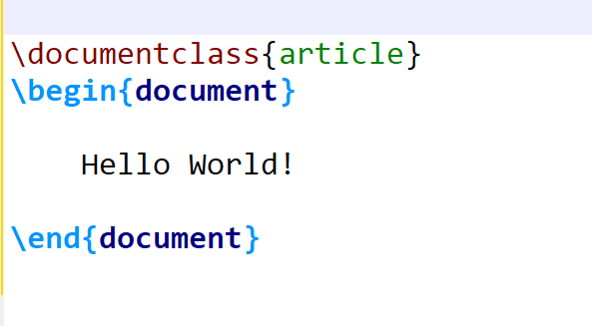
The basic layout of a LaTeX file
Practice-1

Slide 28
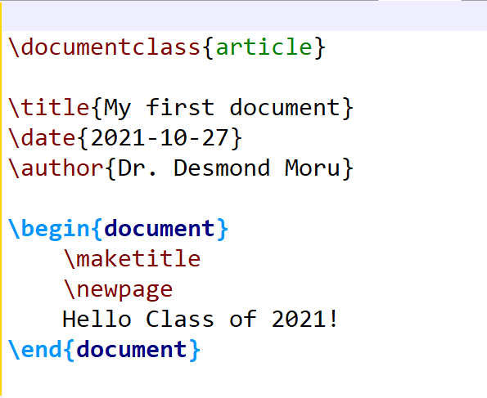
Adding a title page
Practice-2

Slide 29
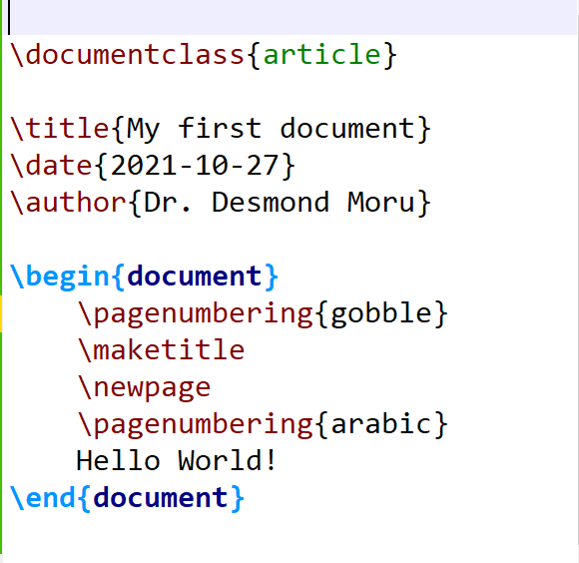
Add/Remove page number
Practice-3

Slide 30
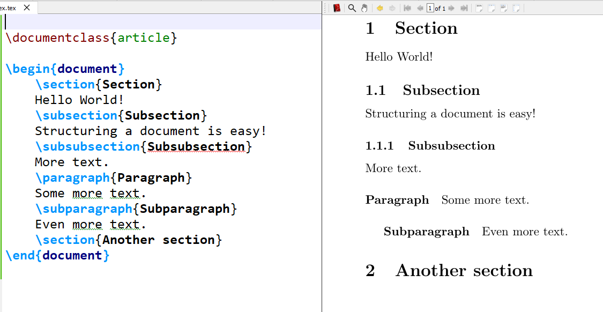
Hierarchy of sectioning elements
Practice-4

Slide 31
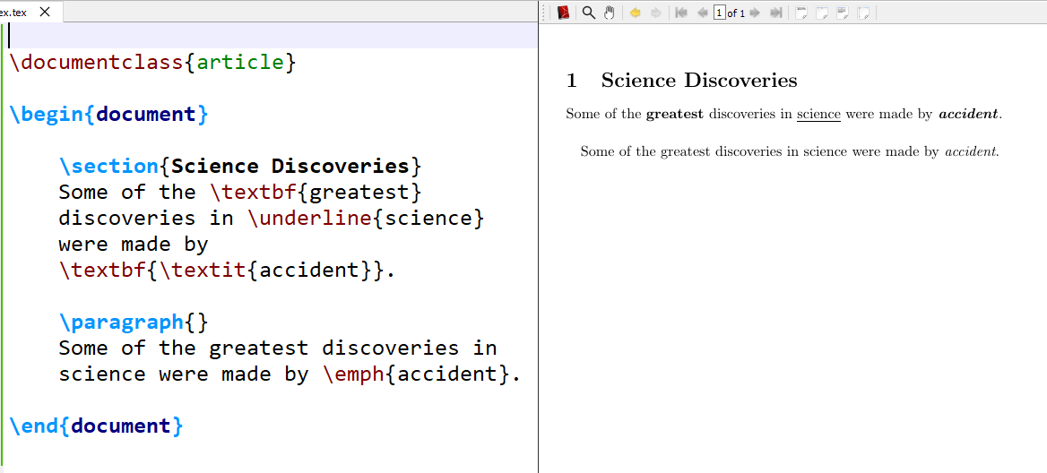
Bold, Italic and Underline Font
Practice-5

Slide 32
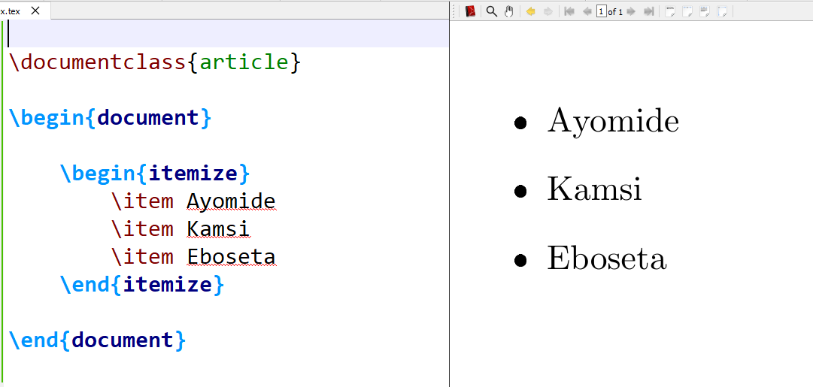
Unordered List (Itemization)
Practice-6

Slide 33
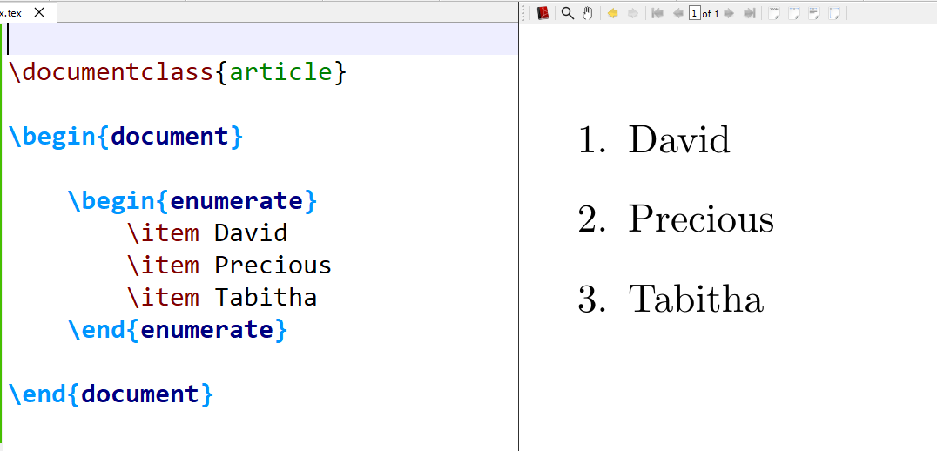
Ordered List (Itemization)
Practice-7

Slide 34
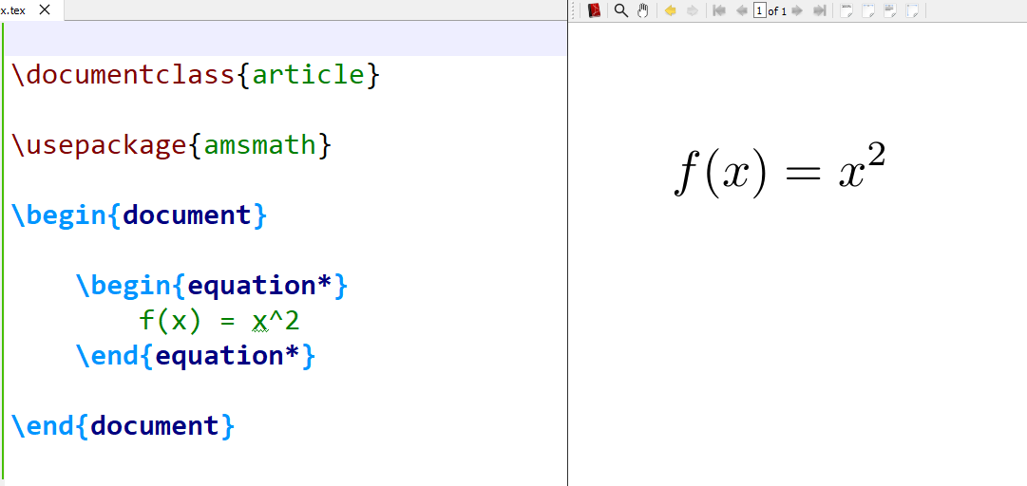
Using LaTeX packages
Practice-8

Slide 35
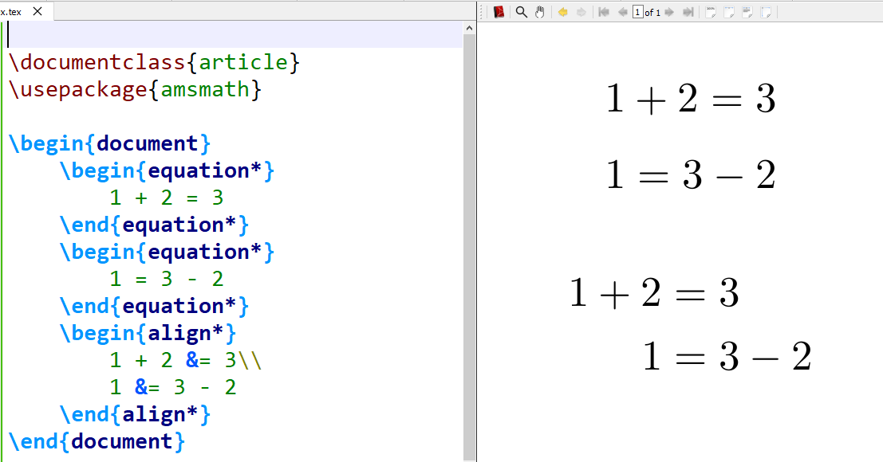
Equation and align environment
Practice-9

Slide 36
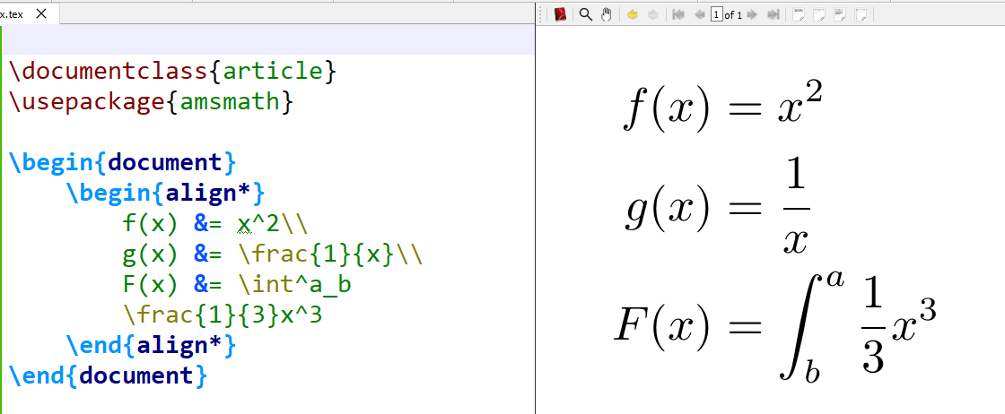
Fractions and more
Practice-10

Slide 37
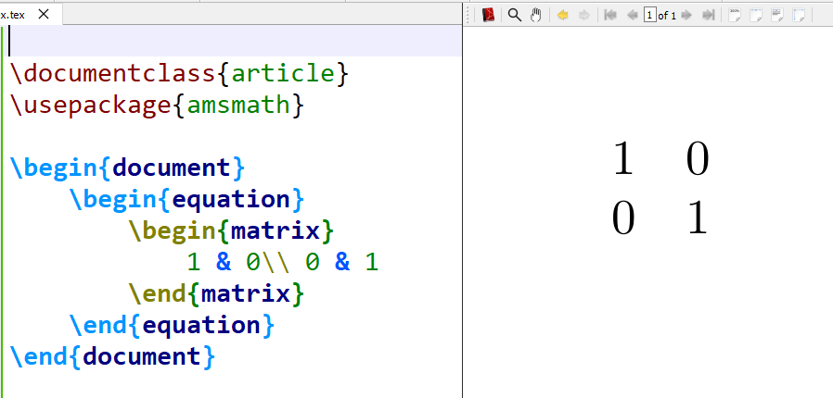
Matrices I

Slide 38
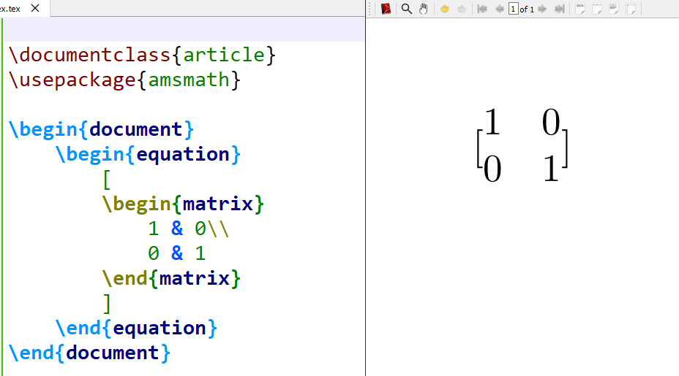
Matrices II

Slide 39
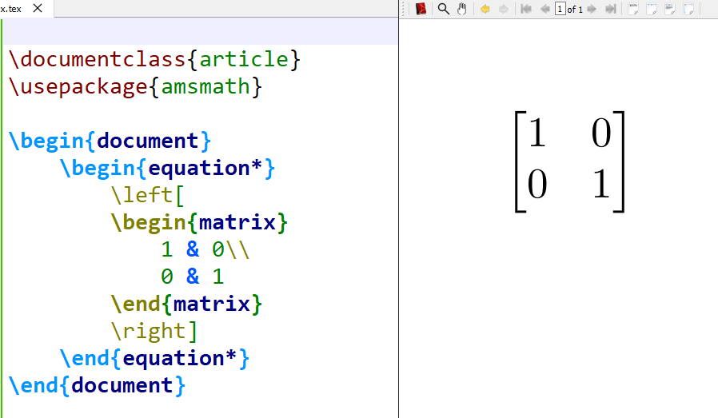
Matrices III

Slide 40
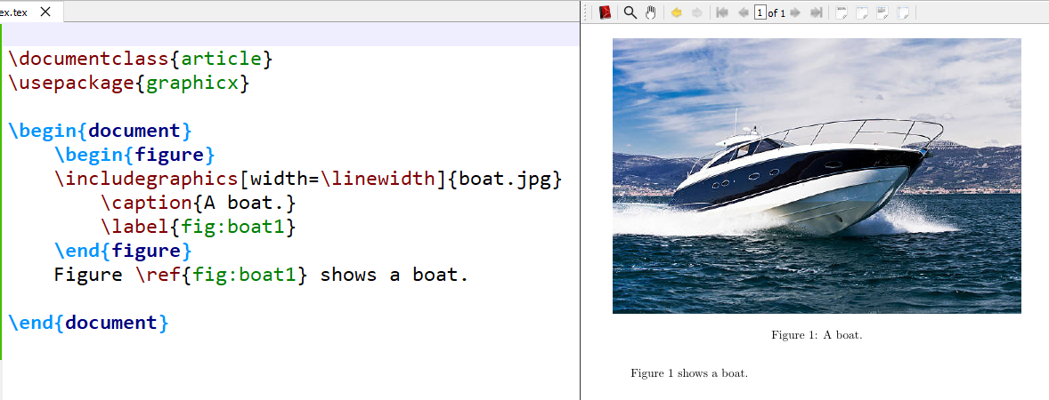
Insert an image in LaTeX

Slide 41
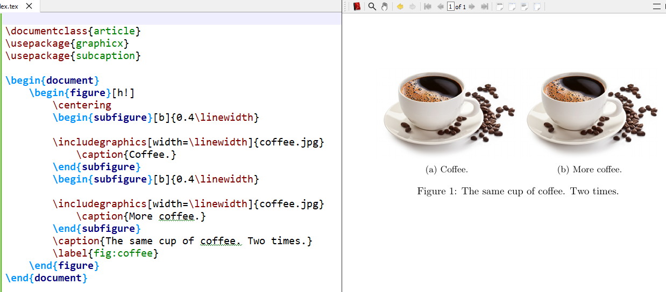
Multiple images/subfigures

Slide 42
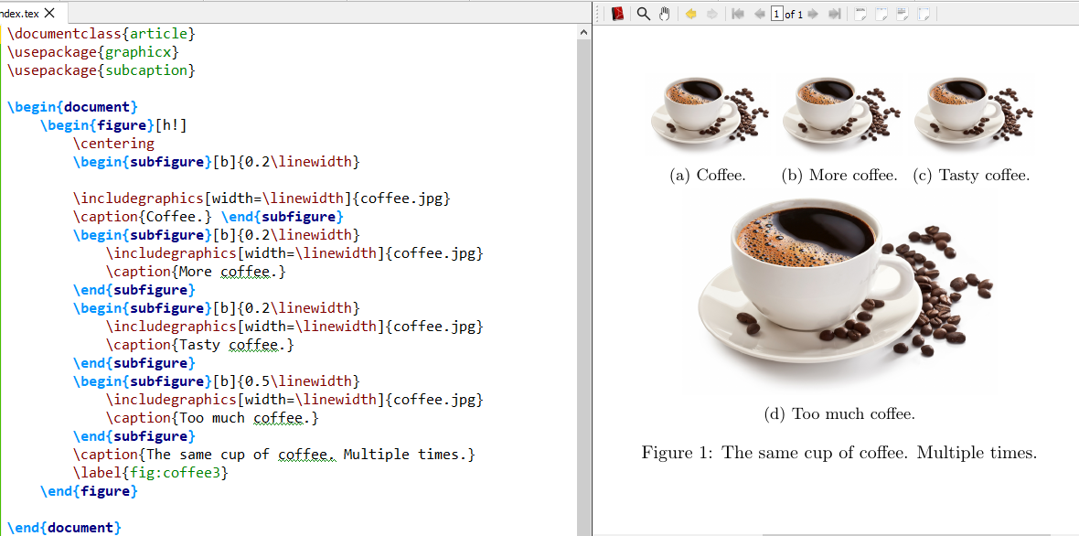
Multiple rows images/subfigures

